Slide 1

Global cooperation- protecting life on earth
THE RECYCLE BIN
OF
PLANET EARTH

Slide 2
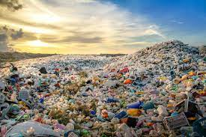
Waste Management
What is waste management?
Waste management refers to the practice of collecting, transporting, processing or disposing of, managing and monitoring various waste materials.
It is important to observe sustainability in this aspect so that every bit of waste can be managed in an efficient manner rather than just dumping it all in landfills.
.

Slide 3
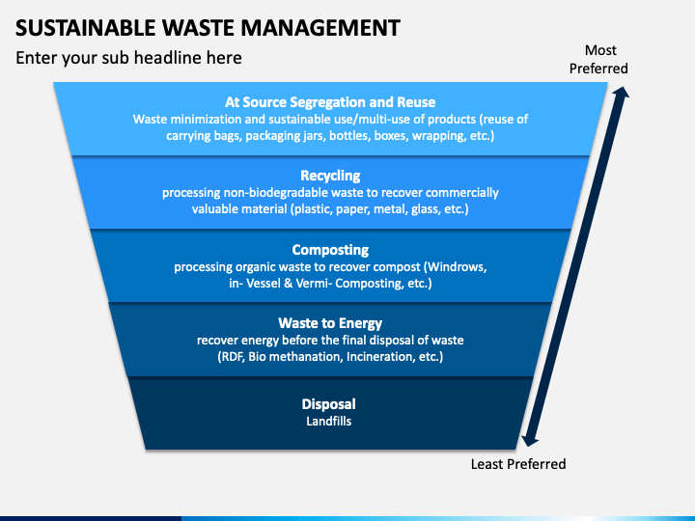
Sustainable Waste Management
Sustainable waste management refers to the collection, transportation, valorization and disposal of the various types of waste, in a manner that does not jeopardize the environment, human health or future generations.

Slide 4

Why Sustainable Waste Management Is Important
1. It creates space
If waste was never managed, it would end up on land, either scattered or may be centralized in a landfill somewhere. Landfills are big and can use up a lot of space. In some confined areas, you will have to sustainably control and manage your waste, so that you make the best use of it.
2. It saves and also makes money
Once you reuse or recycle anything, you will not need to go buy another of the same. You will be saving some money that would otherwise be used to buy an item that can be recycled or reused.
Increasing recycling can cut our disposal costs and improve our bottom line.

Slide 5
Why Sustainable Waste Management Is Important
3. It controls pollution
Each waste we dump has a particular effect on the environment. For instance, pharmaceutical waste poisons our water, and waste foods invite flies and rodents.
4. It is the core of environmental conservation
The greatest enemy to the environment is humans.
We produce trash at an incredibly quick rate and our waste management methods are still poor.
Sustainable waste management is therefore at the core of environmental conservation, seeing as it will help preserve the environment as well as improve it, not only for us but also for other species and future generations.
5. It makes us into better and responsible inhabitants of the earth
Humans cannot live without generating waste. As such, sustainable waste management will help us become better and responsible citizens of the planet by carefully, effectively and sustainably managing our waste.

Slide 6


Best Solutions for Sustainable Waste Management
1.Go paperless
Despite the world becoming more technologically advanced, most businesses still use paper and ink, which is one of the biggest waste categories. To become sustainably responsible for the environment, we need to cut down the amount of paper and ink we use.
2. Donate anything useful
Donate some of the stuff you no longer use or need as they will benefit those who receive them. For instance, restaurants, hotels and grocery stores should donate extra, perishable and prepared food to shelter homes and food banks .

Slide 7
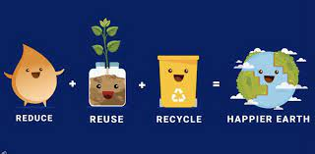
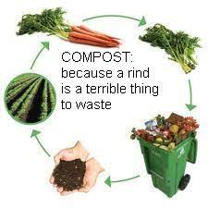
Best Solutions for Sustainable Waste Management
3. Reduce, reuse, recycle
Recycling saves energy, keeps materials out of landfills and incineration, and provides raw materials for new products. reuse some products like plastic bottles instead of throwing them away as soon as you use them.
4. Compost your lunches
Composting is a green and great way of disposing of waste. At home, put the food in a bag and while at work, do it in the break room or cafeteria.

Slide 8
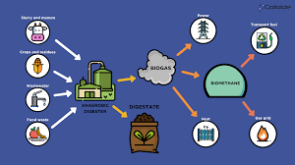
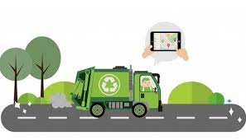
Best Solutions for Sustainable Waste Management
5. Anaerobic digestion of waste
This is a process like composting, although it does not use oxygen. Anaerobic digestion allows the treatment of organic waste and sludge by fermentation, in the absence of oxygen. The materials or waste are sealed off and the bacteria lives of the organic matter itself.
6. Waste collection
The waste collection should not be left to the municipal authorities but should be the responsibility of every individual, business, organization and government.

